Slide 1


Joint Optimization for Power-Constrained MIMO Systems: Is Low-Resolution DAC Still Optimal?
2025 IEEE 101st Vehicular Technology Conference
Jiwon Sung
M.S. Student
School of Electrical Engineering
KAIST

Slide 2
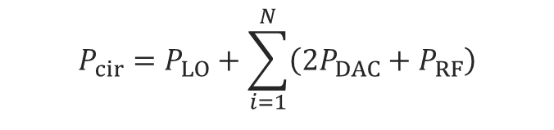
Power Consumption Challenge
01
Multi-user multiple-input multiple-output (MU-MIMO) systems
Adding more antennas at a base station can boost the spectral efficiency of users.
Circuit power consumption can become very large
Im
Precoder
DAC
RF chain
Re
Im
Re
DAC
RF chain
Base station
Im
Re
DAC
RF chain
Excessive power consumption!
$$P_{cir}=P_{LO}+\sum_{i=1}^{N}{\left(2P_{DAC}+P_{RF}\right)}$$

Slide 3
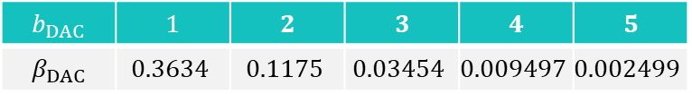
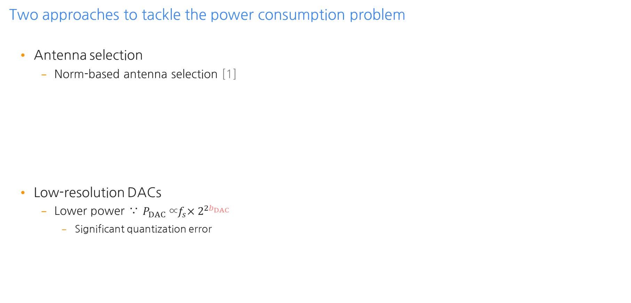




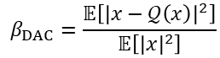
Conventional Approaches
01
Two approaches to tackle the power consumption problem
Antenna selection
Norm-based antenna selection [1]
Low-resolution DACs
Lower power ∵ $P_{DAC}{\text{∝}f}_{s}×2^{2b_{DAC}}$
Significant quantization error
Precoder
DAC
DAC
User $1$
DAC
User $2$
DAC
Turned off!
# of quantization bits
Precoder
4-bit
4-bit
User $1$
[2]
$$b_{DAC}$$ | $$1$$ | $$2$$ | $$3$$ | $$4$$ | $$5$$
$$β_{DAC}$$ | $$0.3634$$ | $$0.1175$$ | $$0.03454$$ | $$0.009497$$ | $$0.002499$$
4-bit
User $2$
4-bit
$$β_{DAC}=\frac{𝔼\left[{\left|x−𝒬\left(x\right)\right|}^{2}\right]}{𝔼\left[{\left|x\right|}^{2}\right]}$$

Slide 4


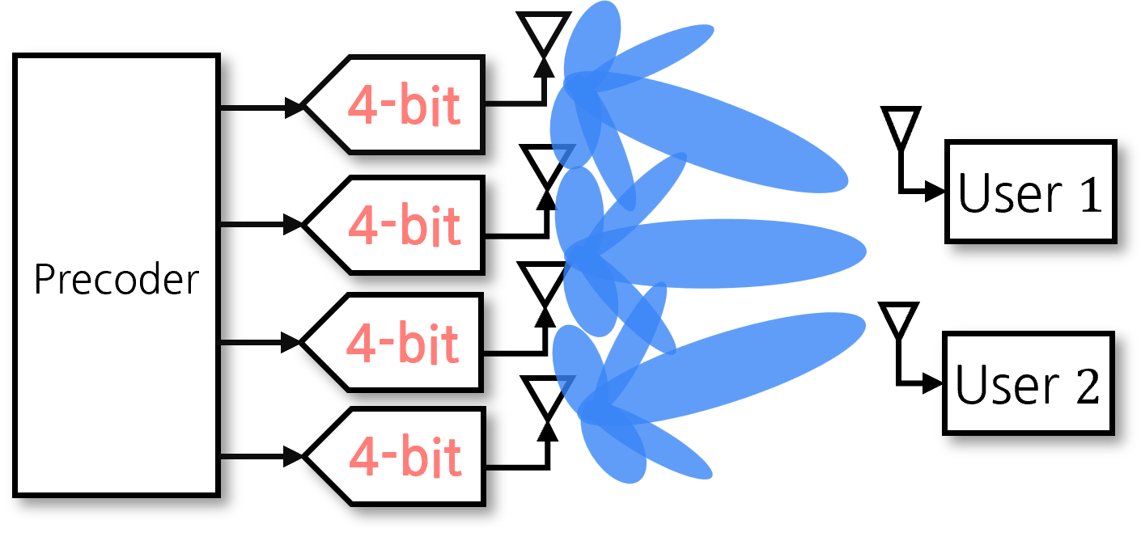
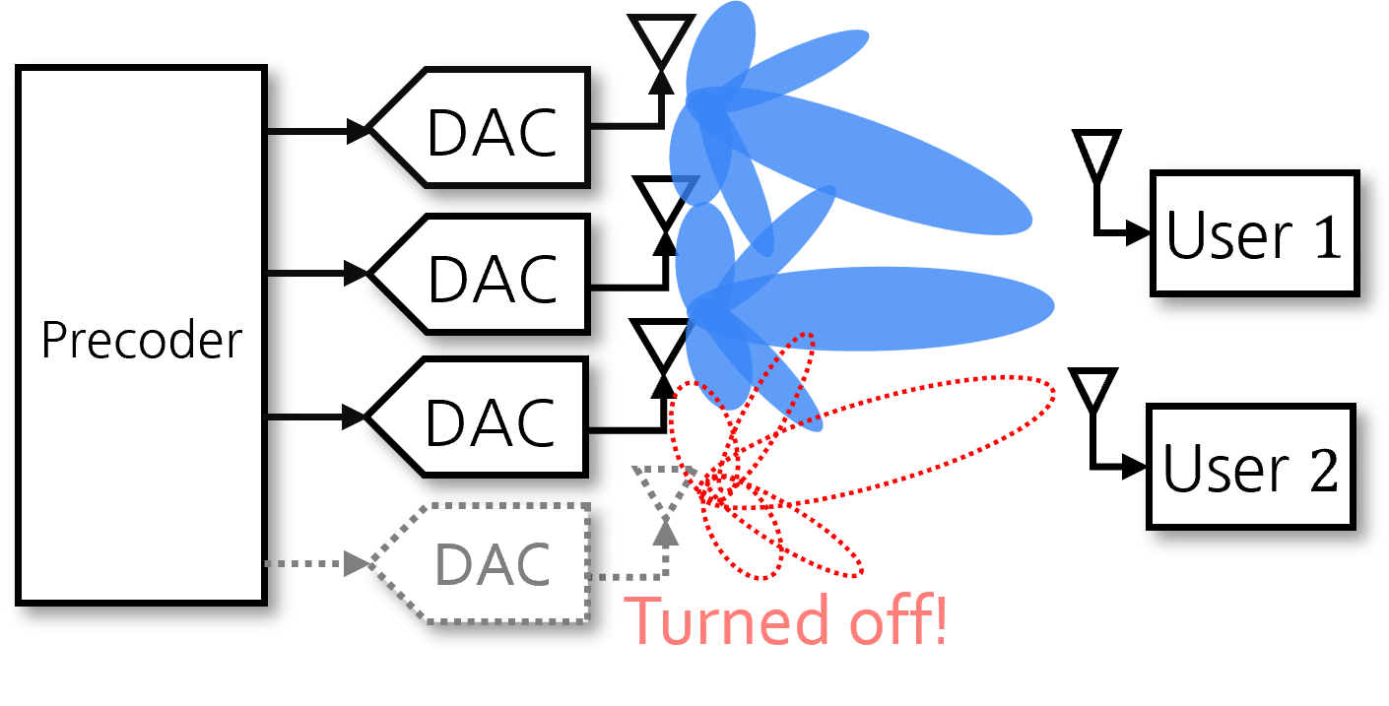
Limitation of Conventional Approaches
01
Prior Works
Precoding using low-resolution DACs
Precoding using antenna selection
3~5 bits are the most power-efficient [3]
Circuit power consumption was ignored [4], [5]
Circuit power consumption was considered
Energy efficiency was mostly optimized [6], [7]
→ Did not explicitly optimize spectral efficiency
A more comprehensive optimization with a fixed power budget at the base station?

Slide 5
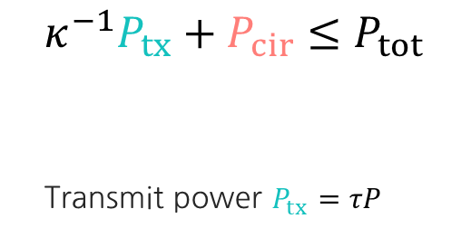
Motivation
01
A comprehensive optimization for maximizing the sum spectral efficiency
$$κ^{−1}P_{tx}+P_{cir}≤P_{tot}$$
Transmit power $P_{tx}=τP$
Tx Pow
Cir.
Pow
vs
Tx Pow
Cir.
Pow
Joint optimization of antenna selection, precoding, and transmit power control
Strategic balancing of the transmit power and antenna deployment
More room for the use of medium/high-resolution DACs?

Slide 6

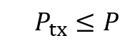
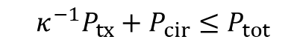
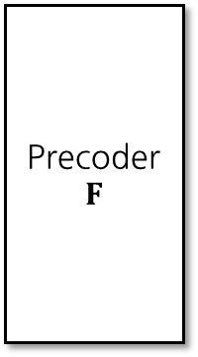




System Model
02
Downlink MU-MIMO communication system
Im
Precoder
$$F$$
RF chain
User $1$
Re
DAC
Im
DAC
RF chain
Re
User $2$
Im
…
DAC
RF chain
Re
Total power constraint:
$$κ^{−1}P_{tx}+P_{cir}≤P_{tot}$$
User $k$
Tx power constraint:
$$P_{tx}≤P$$
Selecting subset of $N$ antennas
Goal: maximize the sum spectral efficiency of users

Slide 7
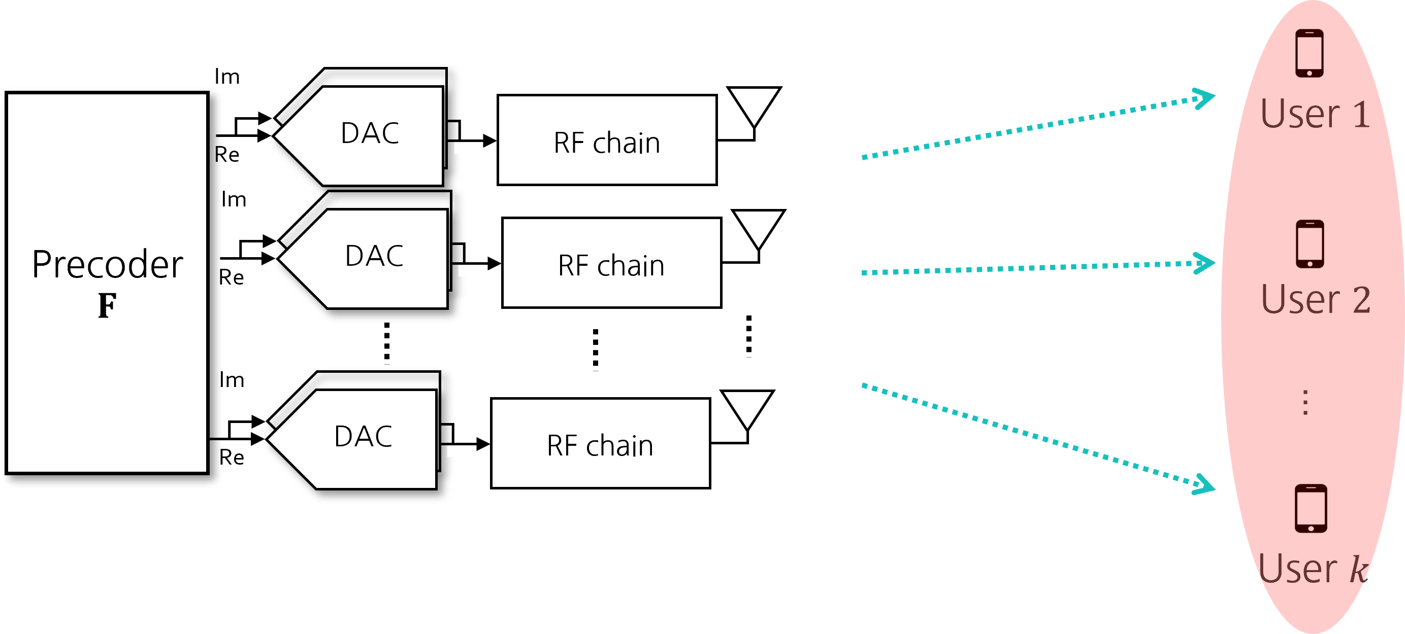

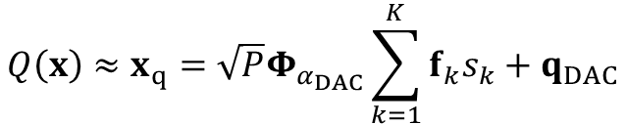
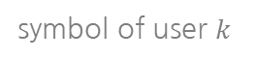
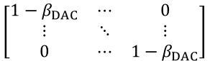
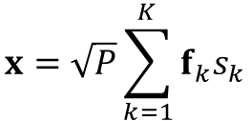
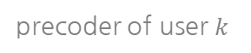

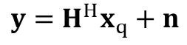
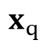
Quantization Error Approximation
02
Additive quantization noise model (AQNM)
Tx Signal
symbol of user $k$
AQNM
Quantized Signal
$$x=\sqrt{P}\sum_{k=1}^{K}{f_{k}s_{k}}$$
$$Q\left(x\right)≈x_{q}=\sqrt{P}Φ_{α_{DAC}}\sum_{k=1}^{K}{f_{k}s_{k}}+q_{DAC}$$
[8]
precoder of user $k$
quantization loss matrix
$$\left[\begin{matrix}1−β_{DAC} & ⋯ & 0 \\ ⋮ & ⋱ & ⋮ \\ 0 & ⋯ & 1−β_{DAC}\end{matrix}\right]$$
$$H$$
Rx Signal
$$x$$
$$x_{q}$$
$$y=H^{H}x_{q}+n$$
Linear approximation of the quantization process

Slide 8
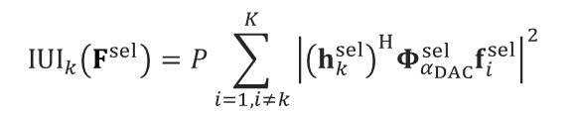
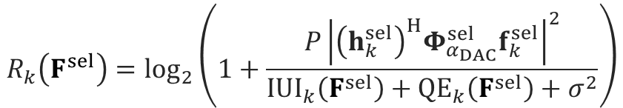
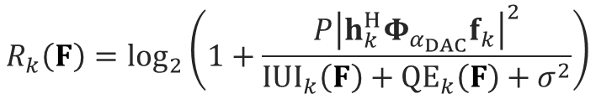
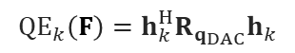
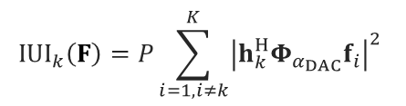
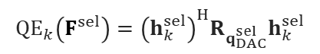
Performance Metric
02
Spectral efficiency of user $k$
Without antenna selection
With antenna selection
$$R_{k}\left(F^{sel}\right)=\log_{2}\left(1+\frac{P{\left|{\left(h_{k}^{sel}\right)}^{H}Φ_{α_{DAC}}^{sel}f_{k}^{sel}\right|}^{2}}{IUI_{k}\left(F^{sel}\right)+{QE}_{k}\left(F^{sel}\right)+σ^{2}}\right)$$
$$R_{k}\left(F\right)=\log_{2}\left(1+\frac{P{\left|h_{k}^{H}Φ_{α_{DAC}}f_{k}\right|}^{2}}{IUI_{k}\left(F\right)+{QE}_{k}\left(F\right)+σ^{2}}\right)$$
$$IUI_{k}\left(F\right)=P\sum_{i=1,i≠k}^{K}{{\left|h_{k}^{H}Φ_{α_{DAC}}f_{i}\right|}^{2}}$$
$$IUI_{k}\left(F^{sel}\right)=P\sum_{i=1,i≠k}^{K}{{\left|{\left(h_{k}^{sel}\right)}^{H}Φ_{α_{DAC}}^{sel}f_{i}^{sel}\right|}^{2}}$$
$${QE}_{k}\left(F\right)=h_{k}^{H}R_{q_{DAC}}h_{k}$$
$${QE}_{k}\left(F^{sel}\right)={\left(h_{k}^{sel}\right)}^{H}R_{q_{DAC}^{sel}}h_{k}^{sel}$$
However, antenna selection may not bring rate losses!

Slide 9
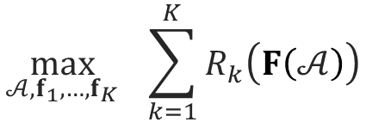
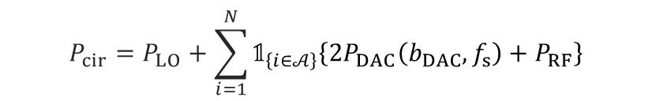
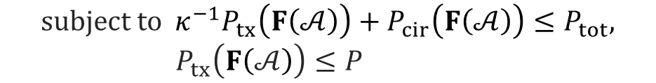
Problem Formulation
02
Sum rate maximization problem & challenges
$$\max_{𝒜, f_{1},…,f_{K}}{ \sum_{k=1}^{K}{R_{k}\left(F\left(𝒜\right)\right)}}$$
1. Non-convex
$$subject to κ^{−1}P_{tx}\left(F\left(𝒜\right)\right)+P_{cir}\left(F\left(𝒜\right)\right)≤P_{tot},$$
$P_{tx}\left(F\left(𝒜\right)\right)≤P$
3. Circuit power consumption
$$P_{cir}=P_{LO}+\sum_{i=1}^{N}{{\text{𝟙}}_{\left\{i∈𝒜\right\}}\left\{2P_{DAC}\left(b_{DAC}, f_{s}\right)+P_{RF}\right\}}$$
2. Transmit power control
Ant. power consumption
non-smooth function
Biggest challenge: need to deal with the indicator function!

Slide 10
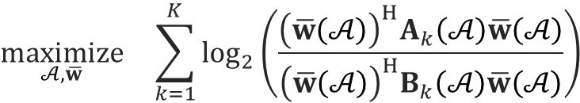
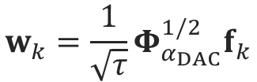

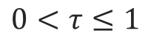
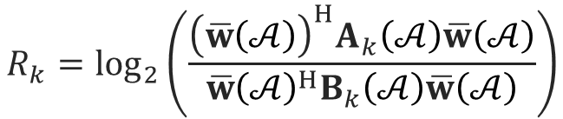

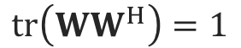
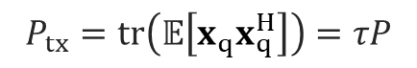
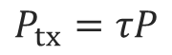
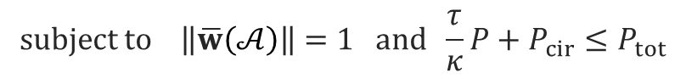
Proposed Method
03
Problem reformulation: sum spectral efficiency
Power control:
Spectral efficiency in Rayleigh quotient form:
$$P_{tx}=τP$$
$$R_{k}=\log_{2}\left(\frac{{\left(\overline{w}\left(𝒜\right)\right)}^{H}A_{k}\left(𝒜\right)\overline{w}\left(𝒜\right)}{{\overline{w}\left(𝒜\right)}^{H}B_{k}\left(𝒜\right)\overline{w}\left(𝒜\right)}\right)$$
$$0<τ≤1$$
Weighted precoding vector:
Reformulated problem (given $τ$):
$$w_{k}={\frac{1}{\sqrt{τ}}Φ}_{α_{DAC}}^{1/2}f_{k}$$
$$\underset{𝒜,\overline{w}}{maximize} \sum_{k=1}^{K}{\log_{2}\left(\frac{{\left(\overline{w}\left(𝒜\right)\right)}^{H}A_{k}\left(𝒜\right)\overline{w}\left(𝒜\right)}{{\left(\overline{w}\left(𝒜\right)\right)}^{H}B_{k}\left(𝒜\right)\overline{w}\left(𝒜\right)}\right)}$$
$$tr\left(WW^{H}\right)=1$$
$$subject to \left\|\overline{w}\left(𝒜\right)\right\|=1 and \frac{τ}{κ}P+P_{cir}≤P_{tot}$$
$$↔$$
$$P_{tx}=tr\left(𝔼\left[x_{q}x_{q}^{H}\right]\right)=τP$$
The objective function is now GPI-friendly!

Slide 11
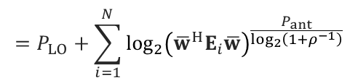
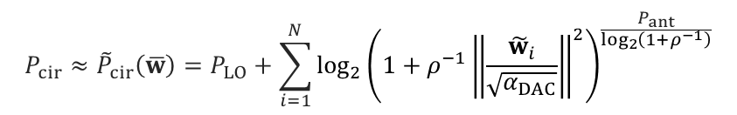
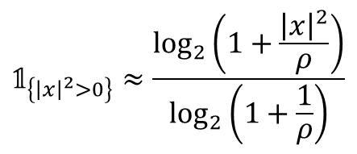
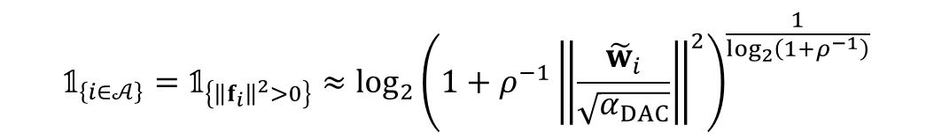
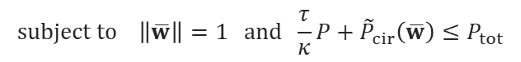
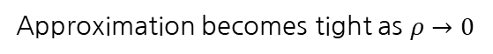
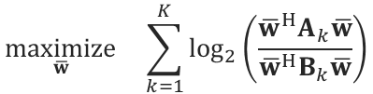
Proposed Method
03
Problem reformulation: indicator function approximation
$${\text{𝟙}}_{\left\{{\left|x\right|}^{2}>0\right\}}≈\frac{\log_{2}\left(1+\frac{{\left|x\right|}^{2}}{ρ}\right)}{\log_{2}\left(1+\frac{1}{ρ}\right)}$$
[9]
$${\text{𝟙}}_{\left\{i∈𝒜\right\}}={\text{𝟙}}_{\left\{{\left\|f_{i}\right\|}^{2}>0\right\}}≈{\log_{2}\left(1+ρ^{−1}{\left\|\frac{{\tilde{w}}_{i}}{\sqrt{α_{DAC}}}\right\|}^{2}\right)}^{\frac{1}{\log_{2}\left(1+ρ^{−1}\right)}}$$
Approximation becomes tight as $ρ→0$
$$P_{cir}≈{\tilde{P}}_{cir}\left(\overline{w}\right)=P_{LO}+\sum_{i=1}^{N}{{\log_{2}\left(1+ρ^{−1}{\left\|\frac{{\tilde{w}}_{i}}{\sqrt{α_{DAC}}}\right\|}^{2}\right)}^{\frac{P_{ant}}{\log_{2}\left(1+ρ^{−1}\right)}}}$$
$$\underset{\overline{w}}{maximize} \sum_{k=1}^{K}{\log_{2}\left(\frac{{\overline{w}}^{H}A_{k}\overline{w}}{{\overline{w}}^{H}B_{k}\overline{w}}\right)}$$
$$=P_{LO}+\sum_{i=1}^{N}{{\log_{2}\left({\overline{w}}^{H}E_{i}\overline{w}\right)}^{\frac{P_{ant}}{\log_{2}\left(1+ρ^{−1}\right)}}}$$
$$subject to \left\|\overline{w}\right\|=1 and \frac{τ}{κ}P+{\tilde{P}}_{cir}\left(\overline{w}\right)≤P_{tot}$$
Approximated problem
$P_{cir}$ is now tractable!

Slide 12
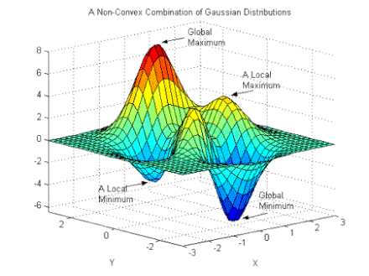

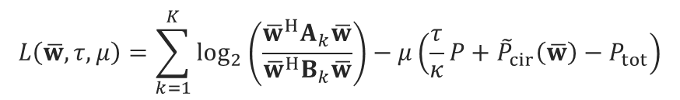
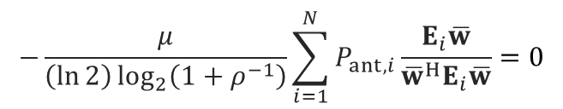
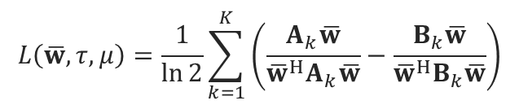

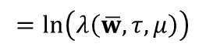
Proposed Method
03
Generalized power iteration (GPI) algorithm
Lagrangian function:
$$B_{KKT}{\left(\overline{w},τ,μ\right)}^{−1}A_{KKT}\left(\overline{w},τ,μ\right)\overline{w}=λ\left(\overline{w},τ,μ\right)\overline{w}$$
$$L\left(\overline{w},τ,μ\right)=\sum_{k=1}^{K}{\log_{2}\left(\frac{{\overline{w}}^{H}A_{k}\overline{w}}{{\overline{w}}^{H}B_{k}\overline{w}}\right)}−μ\left(\frac{τ}{κ}P+{\tilde{P}}_{cir}\left(\overline{w}\right)−P_{tot}\right)$$
Finding principal eigenvector
$∝$ objective function
Principal eigenvector (${\overline{w}}^{⋆}$):
Maximum stationary point
Best local maximum
Eigenvectors:
Stationary points
$$=\ln\left(λ\left(\overline{w},τ,μ\right)\right)$$
Local maximum
First-order optimality condition:
$$L\left(\overline{w},τ,μ\right)=\frac{1}{\ln{2}}\sum_{k=1}^{K}{\left(\frac{A_{k}\overline{w}}{{\overline{w}}^{H}A_{k}\overline{w}}−\frac{B_{k}\overline{w}}{{\overline{w}}^{H}B_{k}\overline{w}}\right)}$$
$$−\frac{μ}{\left(\ln{2}\right)\log_{2}\left(1+ρ^{−1}\right)}\sum_{i=1}^{N}{P_{ant,i}\frac{E_{i}\overline{w}}{{\overline{w}}^{H}E_{i}\overline{w}}}=0$$
Local minimum
Global minimum
The first-order optimality condition is interpreted as a generalized eigenvalue problem

Slide 13
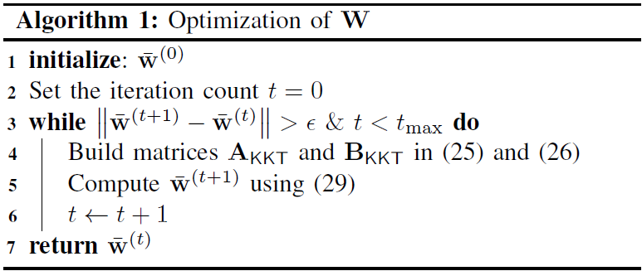
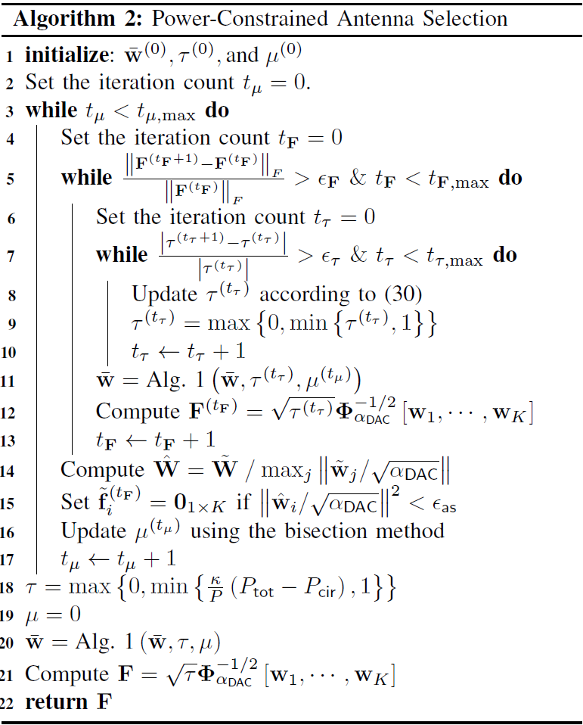
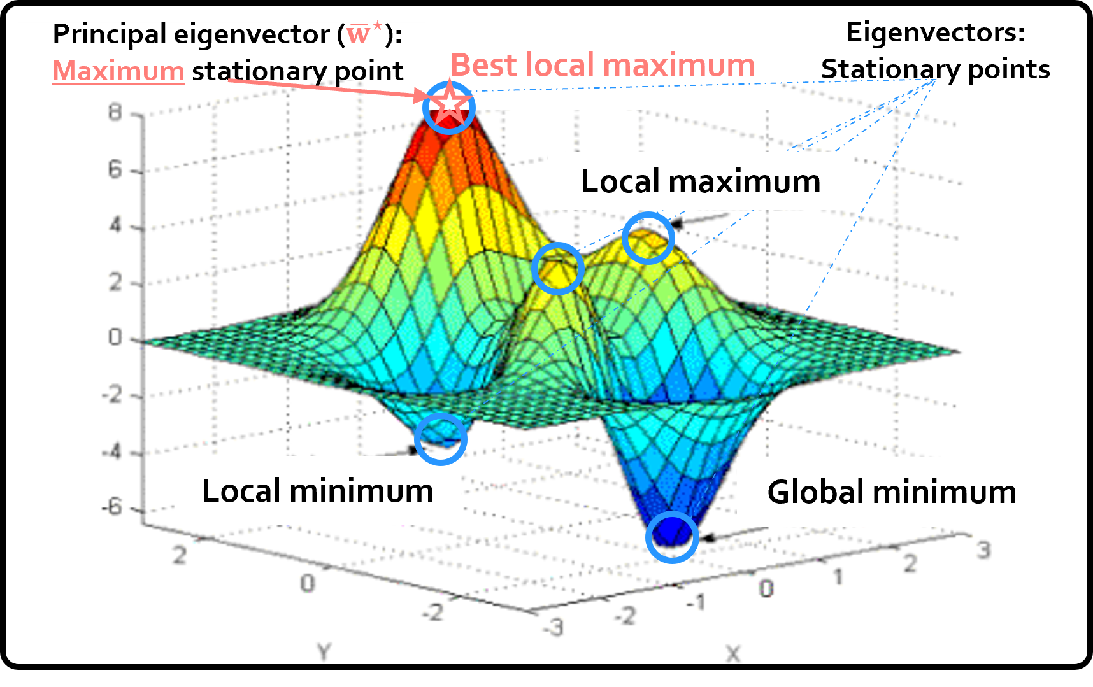

Proposed Algorithm
03
Algorithm 1
Algorithm 2
(Joint precoding & AS)
$→$ Initialize RZF
(Power control)
: Thresholding
Finds the best local optimal solution

Slide 14



Numerical Results
04
Joint Optimization of the Precoder, Antenna Selection, and Power Control
Sum SE w.r.t. DAC resolution
Sum SE w.r.t. the maximum transmit power
Joint AS & PC
$6\sim 10$ bits are optimal
Only power control
High quantization error
High power consumption
Only antenna selection
Medium-resolution DACs can actually be more power efficient!

Slide 15


Conclusion
05
Conclusion
Challenge: circuit power consumption
Solution: joint optimization of the
precoder, AS, and PC
Takeaway $1$: medium-resolution DACs may be more power efficient!
Takeaway $2$: Such comprehensive optimization is needed to use the full potential of the power budget at the BS!
Sum SE w.r.t. DAC resolution
$$P_{cir}=P_{LO}+\sum_{i=1}^{N}{\left(2P_{DAC}+P_{RF}\right)}$$
$6\sim 10$ bits are optimal
High quantization error
High power consumption

Slide 16
References
05
[1] S. Sanayei and A. Nosratinia, “Antenna selection in MIMO systems,” IEEE Commun. Mag., vol. 42, no. 10, pp. 68–73, 2004.
[2] L. Fan, S. Jin, C.-K. Wen, and H. Zhang, “Uplink Achievable Rate for Massive MIMO Systems with Low-Resolution ADC,” IEEE Commun. Lett., vol. 19, no. 12, pp. 2186–2189, Oct. 2015.
[3] I. Atzeni, A. Tölli, and G. Durisi, “Low-Resolution Massive MIMO Under Hardware Power Consumption Constraints,” in Asilomar Conference on Signals, Systems, and Computers, 2021.
[4] S. Jacobsson, G. Durisi, M. Coldrey, T. Goldstein, and C. Studer, “Quantized Precoding for Massive MU-MIMO,” IEEE Trans. Commun., vol. 65, no. 11, pp. 4670–4684, Jul. 2017.
[5] C.-J. Wang, C.-K. Wen, S. Jin, and S.-H. Tsai, “Finite-Alphabet Precoding for Massive MU-MIMO with Low-Resolution DACs,” IEEE Trans. Wireless Commun., vol. 17, no. 7, pp. 4706–4720, Jul. 2018.
[6] E. Vlachos and J. Thompson, “Energy-Efficiency Maximization of Hybrid Massive MIMO Precoding with Random-Resolution DACs via RF Selection,” IEEE Trans. Wireless Commun., vol. 20, no. 2, pp. 1093–1104, 2020.
[7] J. Choi, J. Park, and N. Lee, “Energy Efficiency Maximization Precoding for Quantized Massive MIMO Systems,” IEEE Trans. Wireless Commun., Feb. 2021.
[8] A. K. Fletcher, S. Rangan, V. K. Goyal, and K. Ramchandran, “Robust Predictive Quantization: Analysis and Design via Convex Optimization,” IEEE J. Sel. Topics Signal Process., vol. 1, no. 4, pp. 618–632, Dec. 2007.
[9] B. K. Sriperumbudur, D. A. Torres, and G. R. Lanckriet, “A Majorization-Minimization Approach to the Sparse Generalized Eigenvalue Problem,” Machine learning, vol. 85, no. 1, pp. 3–39, 2011.

Slide 17
Joint Optimization for Power-Constrained MIMO Systems: Is Low-Resolution DAC Still Optimal?
Jiwon Sung jiwonsung [AT] kaist [DOT] ac [DOT] kr

